Slide 1
Mastering NT Greek
17. Contract Verbs
By Ted Hildebrandt © 2003
Baker Academic

Slide 2
Review

Slide 3
2-1-2 Paradigms - Chant this
2 1 2
λόγος γραφή ἱερόν
λόγου γραφῆς ἱεροῦ
λόγῳ γραφῇ ἱερῷ
λόγον γραφήν ἱερόν
λόγοι γραφαί ἱερά
λόγων γραφῶν ἱερῶν
λόγοις γραφαῖς ἱεροῖς
λόγους γραφάς ἱερά

Slide 4
3rd Declension Chantables
χαρίς ὄνομα, πίστις
χάρις ὄνομα πίστις
χάριτος ὀνόματος πίστεως
χάριτι ὀνόματι πίστει
χάριτα ὄνομα πίστιν
χάριτες ὀνόματα πίστεις
χαρίτων ὀνομάτων πίστεων
χάρισι(ν) ὀνόμασι(ν) πίστεσι(ν)
χάριτας ὀνόματα πίστεις

Slide 5
PAI Verb Chant
λύω λύομεν
λύεις λύετε
λύει λύουσι(ν)

Slide 6
The "is" verb PAI -- εἰμί
εἰμί ἐσμέν εἶ ἐστέ ἐστί(ν) εἰσί(ν)

Slide 7
Imperfect εἰμί
ἤμην ἦμεν ἦς ἦτε ἦν ἦσαν

Slide 8
Person Personal Pronoun Chant
Singular Plural
Nom. ἐγώ σύ ἡμεῖς
Gen. μου σου ἡμῶν Dat. μοι σοι ἡμῖν Acc. με σε ἡμάς
αὐτός, αὐτη, αὐτό (he, she, it)

Slide 9
Present Middle/Passive Indicative
λύομαι, -ομεθα -ῃ, -εσθε -εται, -ονται
I am loosed/am being loosed
I loose myself/am loosing [for myself]

Slide 10
Shape of the Future in Greek
λύσω λύσομεν I will loose We will loose
λύσεις λύσετε You will loose You all will loose
λύσει λύσουσι(ν) S/he/it will loose They will loose
Chant this one

Slide 11
Future Middle Paradigm
λύσομαι -όμεθα -ῃ -εσθε -εται -ονται
I will loose (for myself) We will loose (for ourselves) …

Slide 12
Demonstrative and Relative Pronouns Summary
ἐκεῖνος, ἐκείνη, ἐκεῖνο = that
οὗτος, αὕτη, τοῦτο τούτου, ταύτης, τούτου = this
ὅς ἥ ὅ = Relative (who, which) οὗ ἧς οὗ

Slide 13
Imperfect Active Paradigm of λύω
Chant: ἐλυον, ν, ς, ε, μεν, τε, ν I was loosing, …

Slide 14
Imperfect Middle/Passive (IM/PI)
Chant: ἐλυόμην ου, ετο, ομεθα, εσθε, οντο
I was being loosed

Slide 15
Second Aorist Active Chant
ἔλαβον ν, σ, ε, μεν, τε, ν

Slide 16
Second Aorist Middle Chant
ἐγενόμην -ου, -ετο, -ομεθα, -εσθε, -οντο

Slide 17
Aorist Stem Changes -- 8 to know
ἔρχομαι == ἦλθον (I came, went)
βλέπω == εἶδον (I saw)
λέγω == εἶπον (I said)
γίνομαι == ἐγενόμην (I became)
γινώσκω == ἔγνων (I knew)
ἔχω == ἔσχον ( I had)
λαμβάνω == ἔλαβον (I took)
εὑρίσκω == εὗρον (I found)

Slide 18
1st Aorist Active Paradigm
Learn: ἔλυσα: I loosed… --, ς, ε, μεν, τε, ν

Slide 19
1st Aorist Middle Paradigm
Learn: ἐλυσάμην: I loosed for myself -ω, -ατο, -αμεθα, -ασθε, -αντο

Slide 20
Rapping the Lord’s Prayer
Πάτερ ἡμῶν ὁ ἐν τοῖς οὐρανοῖς father our the one in heaven
ἁγιασθήτω τὸ ὄνομά σου make holy name your
ἐλθέτω ἡ βασιλεία σου let come kingdom your
γενηθήτω τὸ θέλημά σου, let be will your

Slide 21
Rapping the Lord’s Prayer
ὡς ἐν οὐρανῷ καὶ ἐπὶ γῆς· as in heaven also on earth
τὸν ἄρτον ἥμῶν τὸν the bread our
ἐπιούσιον δὸς ἡμῖν σήμερον· daily give us today

Slide 22
Introduction to Contract Verbs
What is a contract verb?
Verb stems ending in: α, ε, ο
An example is: ἀγαπάω

Slide 23
2 Scenarios: The big picture
Present and Imperfect:
Vowel of the stem ending and connecting vowel contract
ἀγαπ + ά + ο + μεν = ἀγαπῶμεν
Aorist and Future (the suffix s)
The stem vowel lengthens
ἀγαπ + ά + σ + ομεν = ἀγαπήσομεν

Slide 24
Contraction Rules (FOLDS)
1) First dissimilar overcomes. α, ε, or η which ever one comes first its long vowel is used
α + ε = α + η = long α
ε + η = η
ἀγαπᾶ + ετε = ἀγαπᾶτε
2) Ο overcomes.
ο + α = ω; ε + ω = ω
ἀγαπά + ω = ἀγαπῶ
Except: ε + ο = ου; ο + ε = ου

Slide 25
Contraction Rules (FOLDS)
3) Likes go long.
α + α = α; ε + η = η; ο + ω = ω
Except: ε + ε = ει (ποιε + ετε = ποιεῖτε)
ο + ο = ου;
4). Dissimilar diphthong contracts.
ο + ει = οι; ε + οι = οι; ο + ῃ = οι

Slide 26
Contraction Rules (FOLDS)
5) Same vowel diphthong drops.
ο + ου = ου; ε + ει = ει;
ποιε + εις = ποιεῖς

Slide 27
5 Contraction Rules: FOLDS
1) F irst dissimilar overcomes. goes long α, ε, η
ε + η = η
2) Ο overcomes. ο + ε ε + ο = ου
3) L ikes go long. ε + ε = ει; ο + ο = ου
4) D issimilar diphthong contracts ο + ει = οι
5) S ame vowel diphthong drops
ο + ου = ου

Slide 28
Paradigms for α, ε, and ο types
α type = ἀγαπάω (I love)
Present Active Indicative ἀγαπάω 1 ἀγαπῶ (αω) ἀγαπῶμεν (αομεν) 2 ἀγαπᾷς (αεις) ἀγαπᾶτε (αετε) 3 ἀγαπᾷ (αει) ἀγαπῶσι (αουσι)

Slide 29
Paradigms for α, ε, and ο types
ε type = ποιέω (I do/make)
Present Active Indicative ποιέω
1 ποιῶ (εω) ποιοῦμεν (εομεν) 2 ποιεῖς (εεις) ποιεῖτε (εετε) 3 ποιεῖ (εει) ποιοῦσι (εουσι)

Slide 30
Paradigms for α, ε, and ο types
ο type = πληρόω (I fill)
Present Active Indicative πληρόω
1 πληρῶ (οω) πληροῦμεν (οομεν) 2 πληροῖς (οεις) πληροῦτε (οετε) 3 πληροῖ (οει) πληροῦσι (οουσι)

Slide 31
Lemoners revisited
κρίνω in the future
Actually it goes like this:
κρίνω + σ (replaced by e and then contracted)
κρινω + ε + ω/εις/ει ➔ κρινῶ

Slide 32
Principle Parts
ἀγαπάω, ἀγαπήσω, ἠγάπησα, ἠγάπηκα, ἠγάπημαι, ἠγαπήθην
ποιέω, ποιήσω, ἐποίησα, πεποίηκα, πεποίημαι, ___
πληρόω, πληρώσω, ἐπλήρωσα, πεπλήρωκα, πεπλήρωμαι, ἐπληρώθην

Slide 33
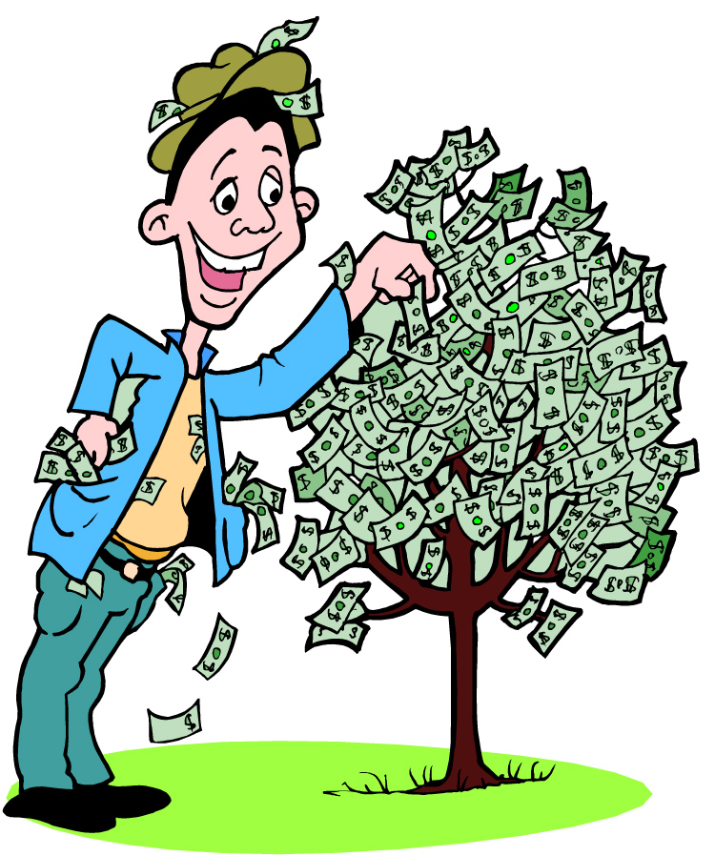
Chapter 17 Vocabulary
εἰ
if, that

Slide 34
Chapter 17 Vocabulary
ἐσθίω
I eat

Slide 35
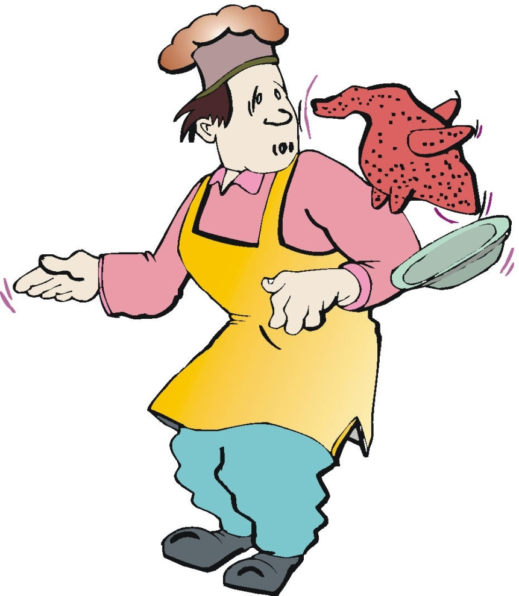
Chapter 17 Vocabulary
ζάω
I live

Slide 36
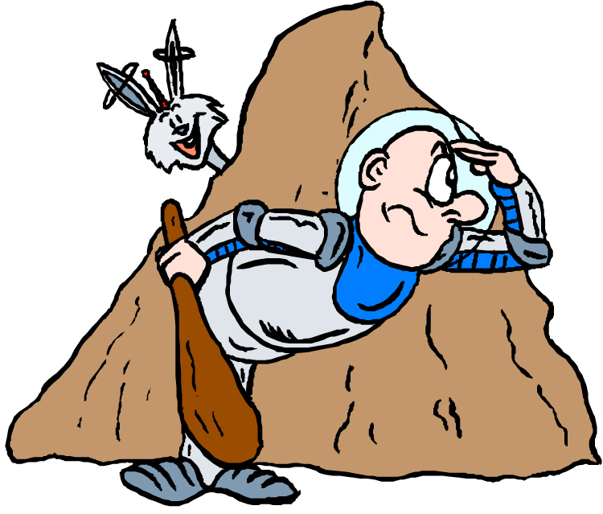
Chapter 17 Vocabulary
ζητέω
I seek

Slide 37
Chapter 17 Vocabulary
ἤ
or, either

Slide 38
Chapter 17 Vocabulary
καλέω
I call

Slide 39
Chapter 17 Vocabulary
λαλέω
I speak, say

Slide 40
Chapter 17 Vocabulary
παρακαλέω
I urge, exhort

Slide 41
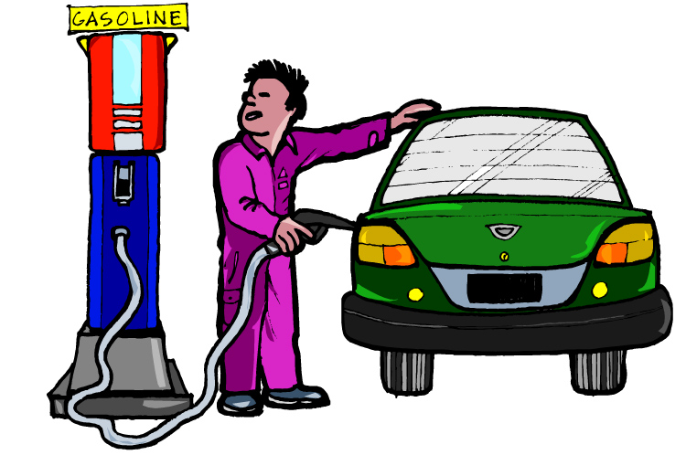
Chapter 17 Vocabulary
πληρόω
I fill, complete

Slide 42
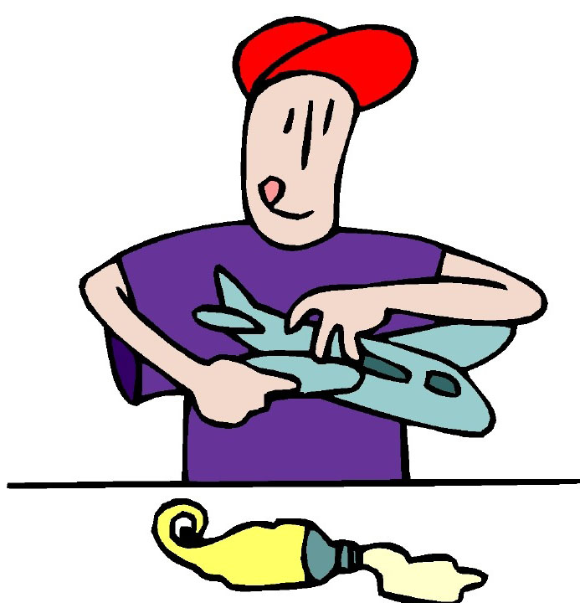
Chapter 17 Vocabulary
ποιέω
I do, make

Slide 43
Quick Vocabulary Review

Slide 44
Ch. 1 -- Vocabulary
angel, messenger
ἄγγελος, -ου, ὁ
verily, truly
ἀμήν
man, humankind
ἄνθρωπος, -ου, ὁ
I
ἐγώ
God
θεός, -οῦ, ὁ

Slide 45
Ch. 1 -- Vocabulary
and, also, even
καί
heart
καρδία, -ας, ἡ
I say
λέγω
prophet
προφήτης, -ου, ὁ
Christ, Messiah
Χριστός, -οῦ, ὁ

Slide 46
Ch. 2 -- Vocabulary
brother
ἀδελφός, -οῦ, ὁ
I hear, obey
ἀκούω
glory, fame
δόξα, -ης, ἡ
I have
ἔχω
world
κόσμος, -ου, ὁ

Slide 47
Ch. 2 -- Vocabulary
Lord, sir
κύριος, -ου, ὁ
word
λόγος, -ου, ὁ
Peter
Πἑτρος, -ου, ὁ
son
υἱός, -οῦ, ὁ
Pharisee
Φαρισαῖος, -ου, ὁ

Slide 48
Ch. 3 -- Vocabulary
but, yet
ἀλλἀ
apostle, sent one
ἀπόστολος, -ου, ὁ
I see
βλέπω
for, then
γάρ
I know
γινώσκω

Slide 49
Ch. 3 -- Vocabulary
Jesus
Ἰησοῦς, -οῦ, ὁ
I take, receive
λαμβάνω
I loose
λύω
heaven
οὐρανός, -οῦ, ὁ
I believe
πιστεύω

Slide 50
Ch. 4 -- Vocabulary
I love
ἀγαπάω
I write
γράφω
but, and
δέ
servant, slave
δοῦλος, -ου, ὁ
I find
εὑρίσκω

Slide 51
Ch. 4 -- Vocabulary
temple
ἱερόν, -οῦ, τό
People
λαός, -οῦ, ὁ
law
νόμος, -ου, ὁ
house
οἶκος, -ου, ὁ
as, about, how
ὡς

Slide 52
Ch. 5 -- Vocabulary
love
ἀγάπη, -ης, ἡ
truth
ἀλήθεια, -ας, ἡ
sin
ἁμαρτία, -ας, ἡ
kingdom
βασιλεία, -ας, ἡ
writing, Scripture
γραφή, -ῆς, ἡ

Slide 53
Ch. 5 -- Vocabulary
I raise up
ἐγείρω
assembly, church
ἐκκλησία, -ας, ἡ
work
ἔργον, -ου, τό
disciple
μαθητής, -οῦ, ὁ
Hour
ὥρα, -ας, ἡ

Slide 54
Chapter 6 Vocabulary
ἀπό (Gen.)
from
διά (Gen.)
through
διά (Acc.)
on account of
εἰς (Acc.)
into

Slide 55
Chapter 6 Vocabulary
ἐκ (Gen.)
out of, from
ἐν (Dat.)
in
ἐπί (Gen.)
on, over
ἐπί (Dat.)
on, at, against, on the basis of

Slide 56
Chapter 6 Vocabulary
ἐπί (Acc.)
on, to, toward, against
κατά (Gen.)
down, against
κατά (Acc.)
according to
μετά (Gen.)
with

Slide 57
Chapter 6 Vocabulary
μετά (Acc.)
after, behind
περί (Gen.)
about, concerning
περί (Acc.)
around, near
πρός (Acc.)
to

Slide 58
Vocabulary -- Ch. 7
good
ἀγαθός, -ή, -όν
Holy
ἅγιος, -α, -ον
righteous
δίκαιοις, -α, -ον

Slide 59
Vocabulary – Ch. 7
I am
εἰμί
Jewish, a Jew
Ἰουδαῖος, -α, -ον
Great
μέγας, μεγάλη, μέγα

Slide 60
Vocabulary -- Ch. 7
dead
νεκρός, -ά, -όν
no, not
οὐ, οὐκ, οὐχ
first
πρῶτος, -η, -ον
voice
φωνή, -ῆς, ἡ

Slide 61
Vocabulary Ch. 8
he/she/it
αὐτός, -ή, -ό
land, earth, region
γῆ, -ῆς, ἡ
I, we
ἐγώ, ἡμεῖς
day
ἡμέρα, -ας, ἡ
that, so that
ὅτι

Slide 62
Vocabulary Ch. 8
so, then, therefore
οὖν
crowd
ὄχλος, -ου, ὁ
from
παρά (with Gen.)
beside, with
παρά (with Dat.)
alongside, beside
παρά (with Acc.)

Slide 63
Vocabulary Ch. 8
you / you (pl)
σύ / ὑμεῖς
by, at the hands of
ὑπό (with Gen.)
under, below
ὑπό (with Acc.)

Slide 64
Vocabulary Ch. 9
I answer
ἀποκρίνομαι
I send
ἀποστέλλω
I throw
βάλλω
I become
γίνομαι
I come in
εἰσέρχομαι

Slide 65
Vocabulary Ch. 9
I go out
ἐξέρχομαι
I come/go
ἔρχομαι
I wish
θέλω
thus, so
οὕτως
I go
πορεύομαι

Slide 66
Vocabulary Ch. 10
life
ζωή, -ῆς, ἡ
death
θάνατος, -ου, ὁ
I judge
κρίνω
I remain
μένω
only, alone
μόνος, -η, -ον

Slide 67
Vocabulary Ch. 10
now
νῦν
and not, nor
οὐδέ
Paul
Παῦλος
I save
σῴζω
then
τότε

Slide 68
Chapter 11 Vocabulary
ἀπέρχομαι
I go away, leave
ἐκεῖνος
that
Ἰουδαῖος, -α, -ον
Jewish
καθώς
as, just as

Slide 69
Chapter 11 Vocabulary
ὅς, ἥ, ὅ
who, which
ὅταν
when
πάλιν
again
οὗτος, αὗτη, τοῦτο
this

Slide 70
Chapter 11 Vocabulary
Πέτρος, -ου, ὁ
Peter
ὑπέρ
for, about (gen.)
above, beyond (acc.)

Slide 71
Chapter 11 Vocabulary
ὑπέρ
for, about (gen.)
above, beyond (acc.)

Slide 72
Chapter 12 Vocabulary
ἀποθνῄσκω
I die
ἐκεῖ
there
ἕως
until
ἰδού
behold

Slide 73
Chapter 12 Vocabulary
ἵνα
in order that, that
Ἰωάννης, -ου, ὁ
John
μέν
on the one hand, indeed
ὅλος, -η, -ον
whole, entire

Slide 74
Chapter 12 Vocabulary
ὅτε
when
σύν
with

Slide 75
Chapter 13 Vocabulary
ἀνήρ, ἀνδρός, ὁ
man, husband
βασιλεύς, -ἐως, ὁ
king
δύναμις, -εως, ἡ
power, miracle
ὄνομα, -ματος, τό
name
πᾶς, πᾶσα, πᾶν
each, every, all

Slide 76
Chapter 13 Vocabulary
πατήρ, πατρός, ὁ
father
πιστις, πίστεως, ἡ
faith, belief
πνεῦμα, -ατος, τό
spirit, wind
σάρξ, σαρκός, ἡ
flesh, body
χάρις, -ιτος, ἡ
grace, kindness

Slide 77
Chapter 14 Vocabulary
αἷμα, -ματος, τό
blood
αἴρω
I raise, take up
διδάσκω
I teach
ἴδιος, -α, -ον
one's own
καλός, -ή, -όν
good

Slide 78
Chapter 14 Vocabulary
μέλλω
I am about to, intend
ὁδός, -οῦ, ἡ
way
πολύς, πολλή, πολύ
much, many
σῶμα, -ματος, τό
body
ψυχή, -ῆς, ἡ
soul, life

Slide 79
Chapter 15 Vocabulary
ἄλλος, -η, -ο
other
ἄρτος, -ου, ὁ
bread
δεῖ
it is necessary
ἐξουσία, -ας, ἡ
authority
ἕτερος, -α, -ον
different

Slide 80
Chapter 15 Vocabulary
ἔτι
yet, still
ὀφθαλμός, -οῦ, ὁ
eye
τέκνον, -ου, τό
child
τόπος, -ου, ὁ
place
φῶς, φωτός, τό
light

Slide 81
Chapter 16 Vocabulary
αἰων, -ῶνος, ὁ
Age, eternity
ἀλλήλων
one another
ἀρχιερεύς, -έως, ὁ
High priest
γυνή, -αικός, ἡ
woman
δύναμαι
I can, am able

Slide 82
Chapter 16 Vocabulary
ἔθνος, -ους, τό
nation
ὅσος, -η, -ον
as great as
πόλις, -εως, ἡ
city
τέ
And, and so
χείρ, χειρός, ἡ
hand

